Slide 1

Keyword extraction from product reviews
Making e-commerce efficient, user-friendly and customizable

Slide 2
Mercado, Your one stop platform for shopping
A Project by Group 1
Jinit Sanghvi
Anudeep Tubati
Sai Sameer Vennam
Swathi Sriram
Anahita Sengar

Slide 3
Motivation behind the project
E-Commerce has become a billion dollar plus industry, with 1.92 billion consumers around the world, the E-Commerce industry continues to grow in the status quo.
E-Commerce has been able to provide a wide array of diverse products, which in turn has also made it difficult for consumers to choose the right product.

Slide 4
Stakeholders involved
Consumers
E-Commerce Websites

Slide 5
The need for a concrete solution
On an average, only 2.86 percent of ecommerce website visits convert into a purchase. This clearly indicates that quite a few users are unable to find the right product or are tired of finding the right product.
Users who have a negative experience on a mobile website are 62 percent less likely to purchase from that business in the future. It is very important to create an environment where consumers can easily find the appropriate product to establish a loyal consumer base.

Slide 6
Our solution
Mercado, an online platform which displays products available from all E-Commerce websites, allowing users to easily navigate through all products available online.
Enables consumers to conveniently compare prices across multiple E-Commerce platforms, and also returns features based on product reviews.

Slide 7
Our solution
To generate and extract key phrases about the product based on the product reviews.
For example, for the product review, ‘The performance is great and it is ergonomically designed, but it’s bulky and the battery life is bad.’ The key phrases would be ‘great performance’, ‘ergonomically designed’, ‘bulky’ and ‘bad battery life’.

Slide 8
Scalability
The best part about the idea is that it can be extended to any business domain where customer feedback and reviews are involved.
For example, this can also be extended to restaurant reviews to extract impactful information about restaurants through restaurant reviews.
We can also scale it to display products from numerous E-Commerce websites.

Slide 9
Salient features of the project
The project has been built from scratch, right from scraping data, to creating a user-friendly interface.
We have scraped data by developing our own scraper.
We have also developed and trained our model on our own and we have used no pretrained models.
We have used algorithms, vectorizers, and neural networks to extract relevant keywords.

Slide 10
Data collection and scraping
A combo of Selenium and Parsel was used to scrape the data from Amazon. The scraping was done using the ‘xpath’ functionality which makes it easy to find an element in an HTML like environment.
Interaction with the website was avoided to the maximum extent by capturing the GET variables in the URL and navigating to each product and review by reconstructing the apt URL and also using try/except blocks in python, in case the classes got rendered differently.

Slide 11
Data pre-processing
Before we start extracting features from product reviews, we have removed all stop words and punctuations.
We have also changed words like ‘haven’t’ to ‘have not’ in order to improve the performance of the model.

Slide 12
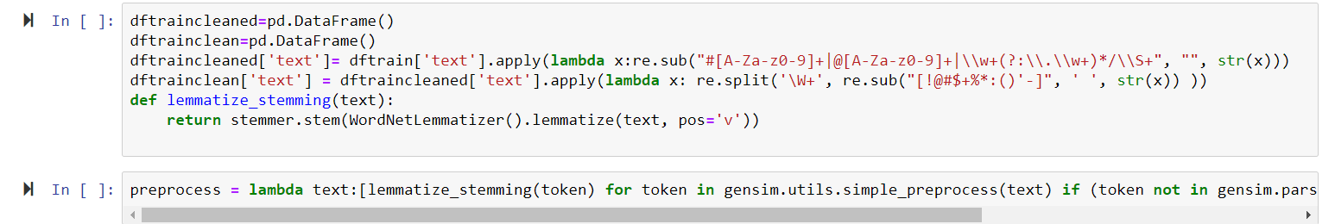
Data pre-processing

Slide 13
modeling
We have used an algorithm which uses a co-occurrence graph to extract key phrases from text.
The keywords are also ranked in order of a score which determines the impact of the keyword in the text.

Slide 14
modeling
However, the algorithm described earlier returns keywords that may not relevantly describe the product and it basically produces a lot of noise.
Hence, we need to find a way to filter out the important and relevant keywords.

Slide 15
modeling
In order to rectify the above difficulty, we train and use neural networks to filter out the irrelevant keywords.
We have also further divided keywords in positive and negative, which allows us to find pros and cons.

Slide 16
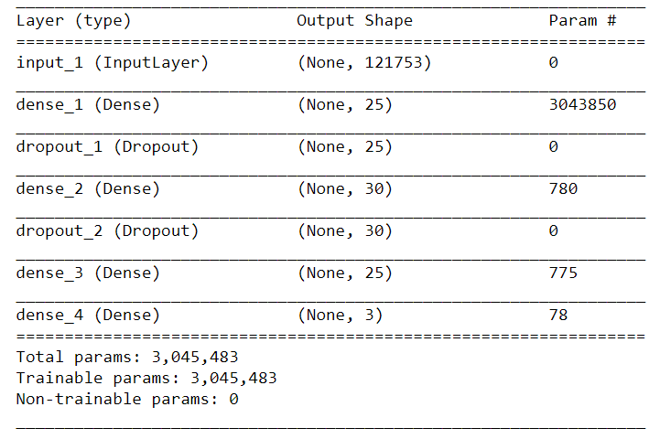
Modeling

Slide 17
evaluation
The dataset we used for training our model was split into two parts, training and validation.
We obtained an accuracy of over 87% on the validation dataset.

Slide 18
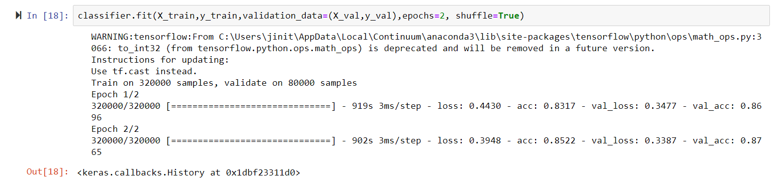
Evaluation

Slide 19
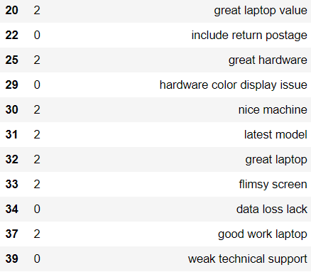
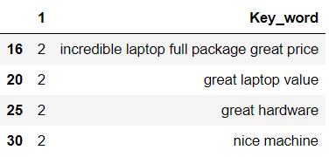
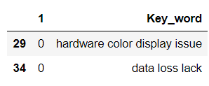
evaluation
After removing noise and redundancy(Cons)
After removing noise and redundancy(Pros)
Keywords with redundancy and noise.

Slide 20
Evaluation
As shown in the above results, our model has been able to extract features and characteristics which will enable consumers to make better choices.
These features greatly summarize the product and make the process of online shopping shorter and convenient.
We have also been able to get rid of redundant keywords to a great extent.

Slide 21
deployment
We have also developed a webpage to show you the user-interface of the project.
It is able to show the products, their pros and cons, along with prices on different E-Commerce platforms.
We can also search for products based on their keywords.

Slide 22
Future improvements
We plan to display and implement our model on all products available on numerous E-Commerce websites but for the sake of the presentation and understanding, we restrict ourselves to a few products available on Amazon.
We could extend our training dataset in order to efficiently cater to products from all categories.

Slide 23
Concluding remarks
We believe our project, ‘Mercado’ makes E-Commerce more user-friendly and real-life as we extract information from reviews posted by consumers.
We help consumers identify and select products best suited for them.

Slide 24
Q&A session

